Slide 1
Approximate Delay-and-Sum Beamforming for Mobile Ultrasound Applications
Josh Kay, Karthik Gopalan

Slide 2
Trends in Ultrasonic Imaging Technology
Growing Number of Elements in Ultrasound Sensor Array
Portable Systems and mobile applications
Challenge: Low power ultrasound solution for mobile applications without compromising image resolution provided by larger sensor array
Proposed Solution: Delay-and-Sum beamforming with Approximate Compute

Slide 3
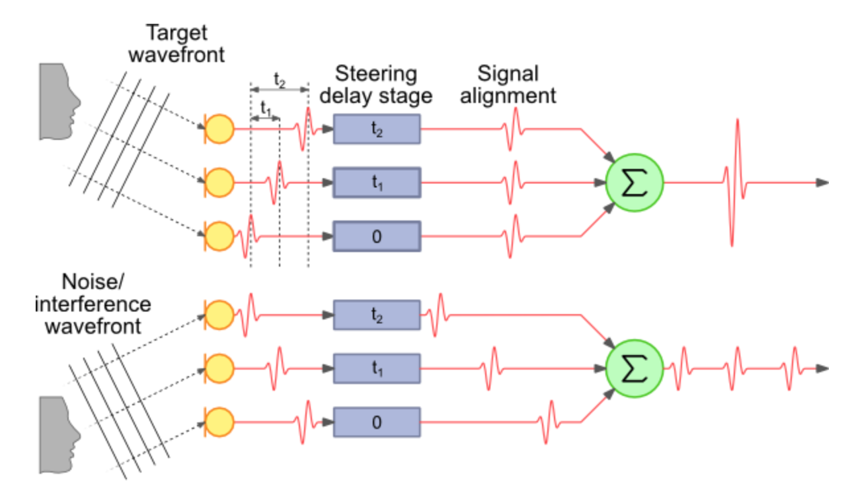
Delay-and-Sum Beamforming
Compensate signal delay to each transducer appropriately before summing the signals
Improves signal to noise ratio (SNR)
Relatively simple

Slide 4
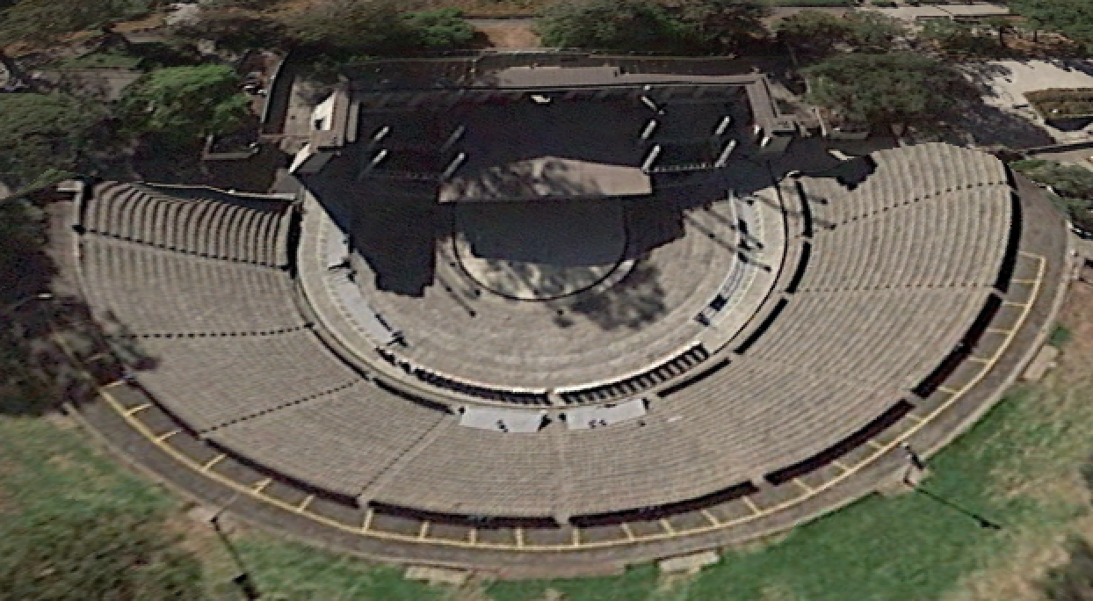
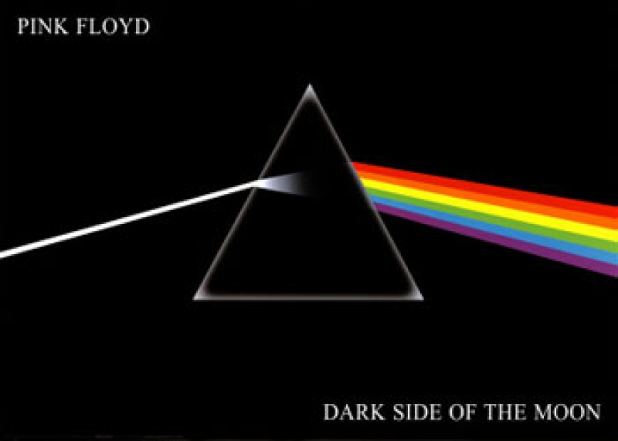

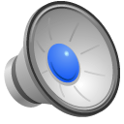
Delay and Sum Example - 1 Microphone

Slide 5
Delay and Sum Example - Microphone Array with Beamforming

Slide 6
Approximate Computing
Deterministic hardware produces low order errors but uses much fewer resources
Save power and area at the expense of accuracy
Possible solution for low power beamforming
Improved resolution must justify increased area and power dissipation

Slide 7
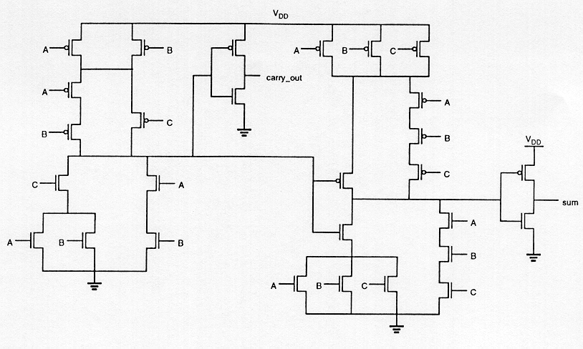
28T Full Adder Cell

Slide 8
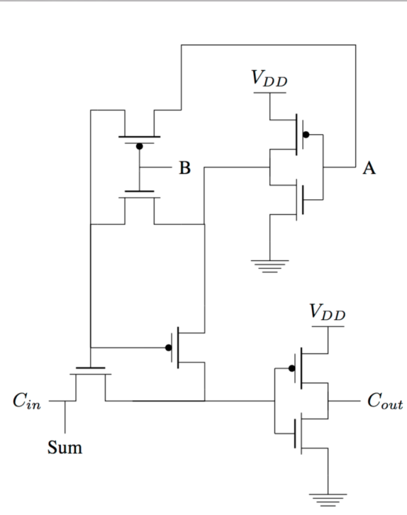
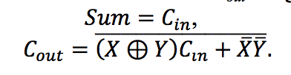
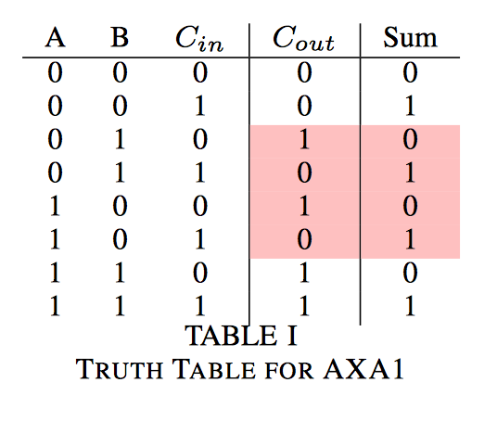
8T Approximate XOR Adder (AXA1)

Slide 9
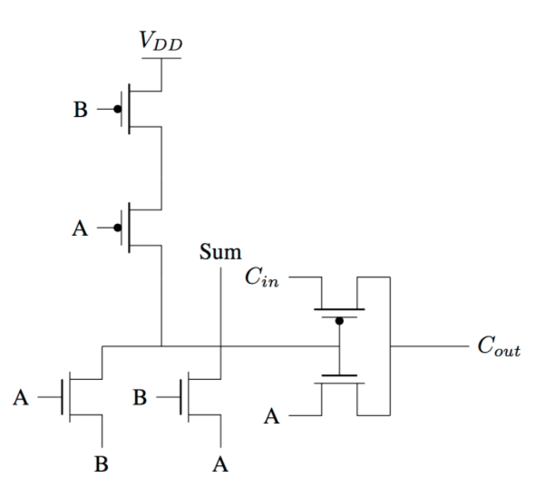
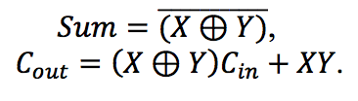
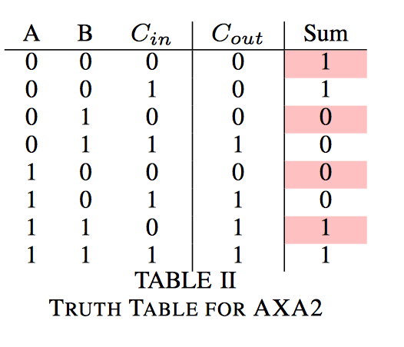
6T Approximate XNOR Adder (AXA2) with Pass Transistor Logic

Slide 10
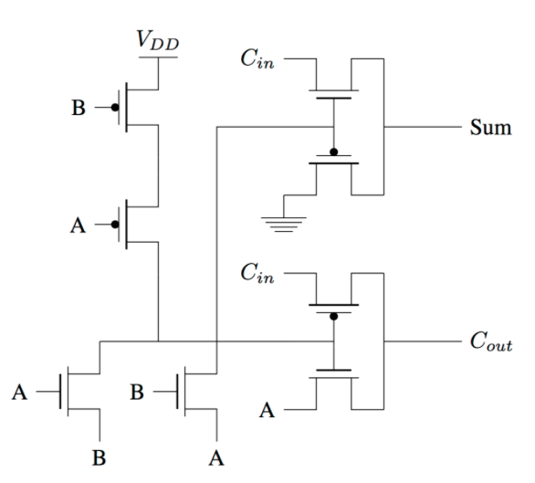
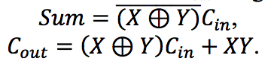
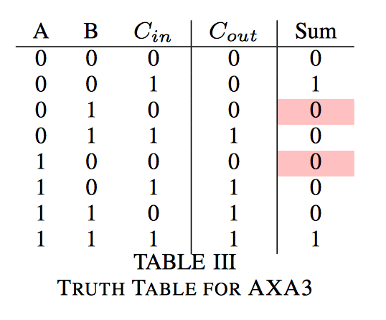
8T Approximate XNOR Adder (AXA3) with Pass Transistor Logic

Slide 11
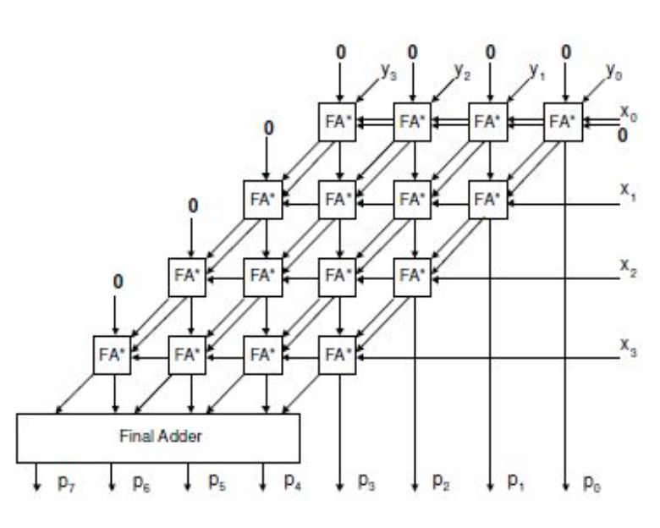
Approximating Multiplications with Carry Save Multipliers
Multiplications performed with 24 bit carry save multiplier with a ripple carry output stage
Used for mantissa operations in a floating point multiplication unit
Various percentages of full adder cells replaced with approximate computing adders

Slide 12
Approximate Computing Gone Wrong

Slide 13
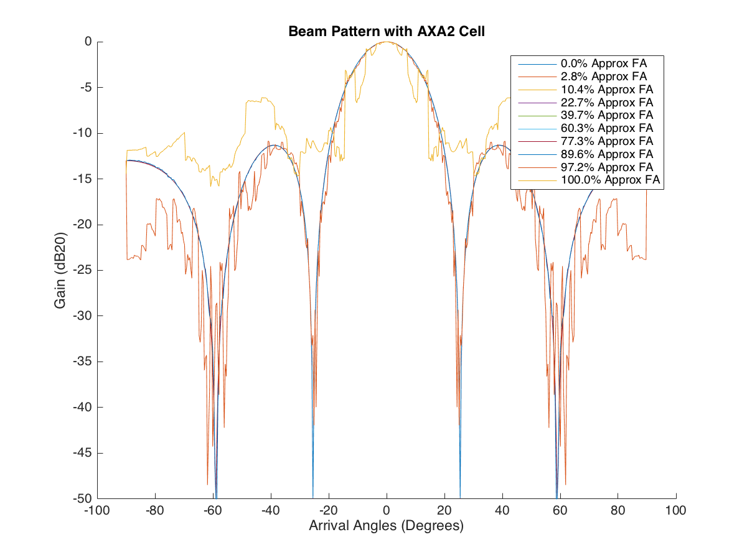
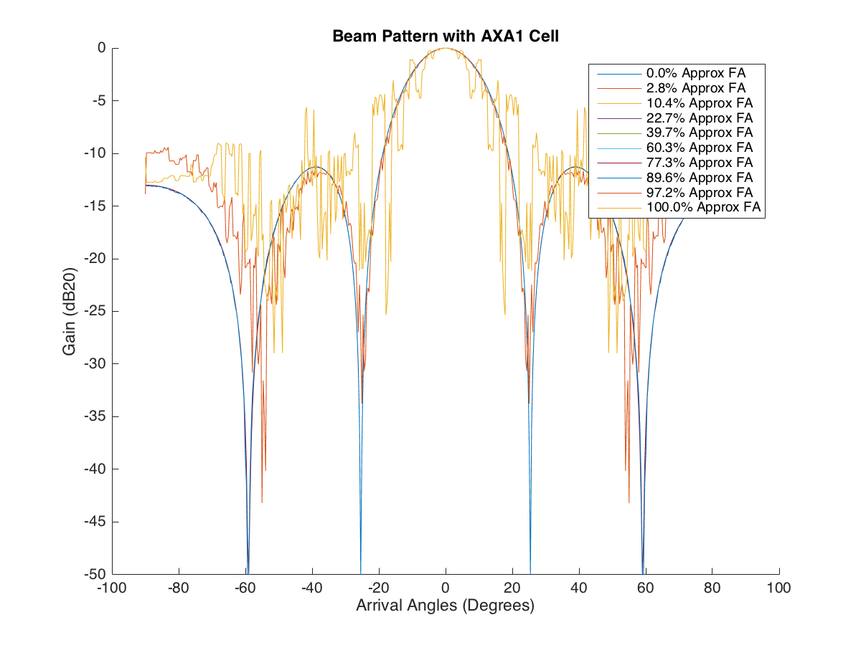
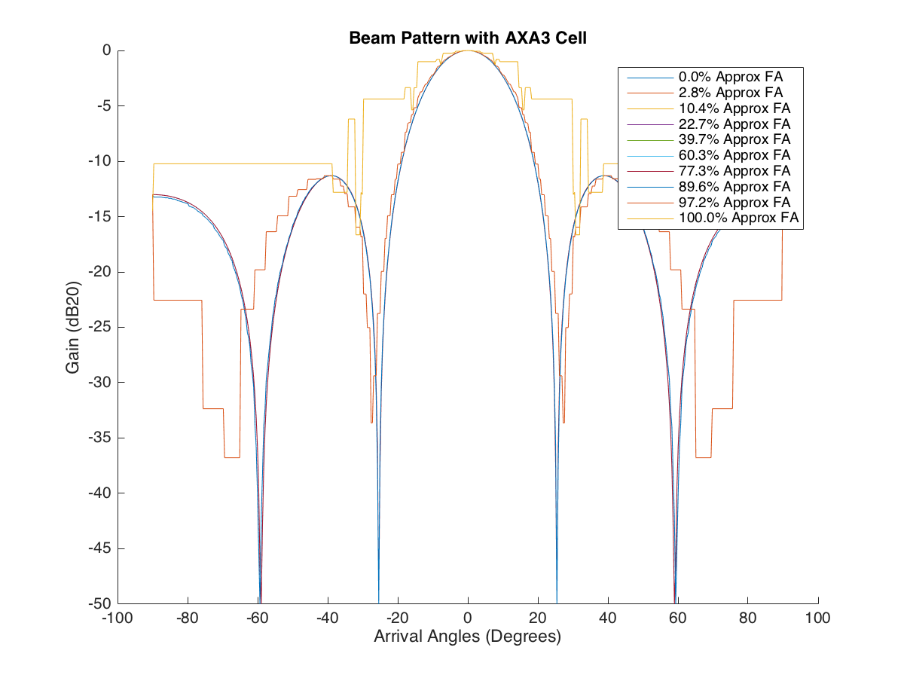
Steered Responses for n bits of Approximation
AXA2
AXA1
AXA3

Slide 14
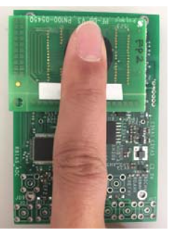
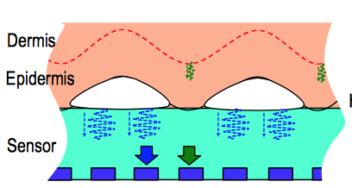
Ultrasonic Fingerprint Sensor
56 x 110 rectangular piezoelectric micromachined ultrasonic transducers (PMUTs)
Aimed for smartphone application
Signals recorded for all 110 columns and 28 rows
Gaussian noise added to degrade SNR
Delay and sum beamforming along columns

Slide 15
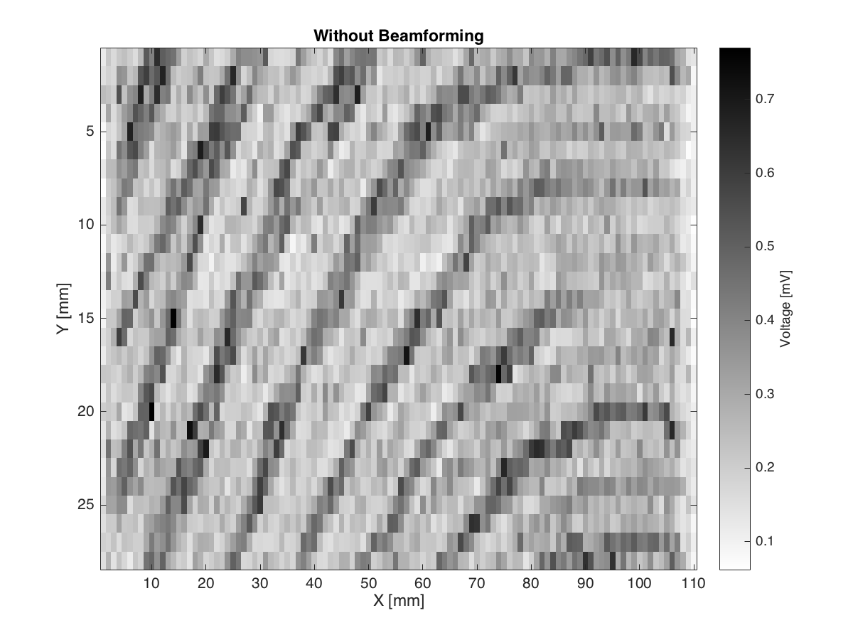
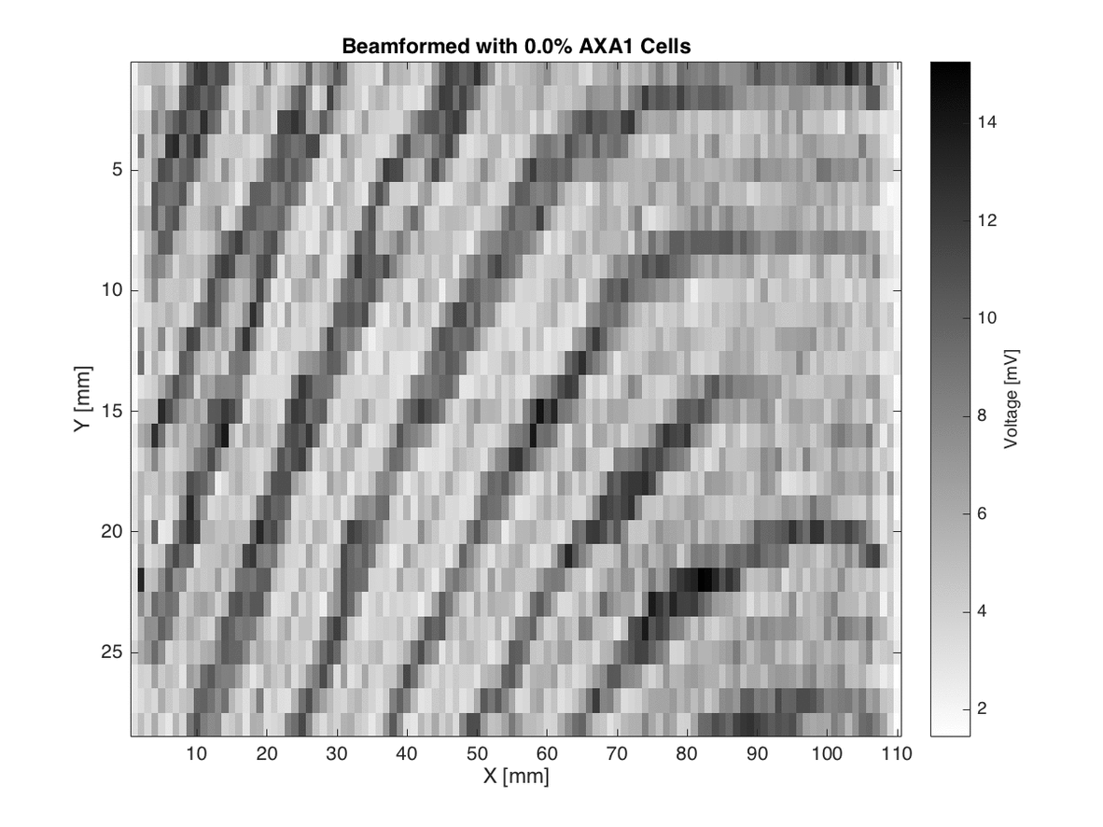
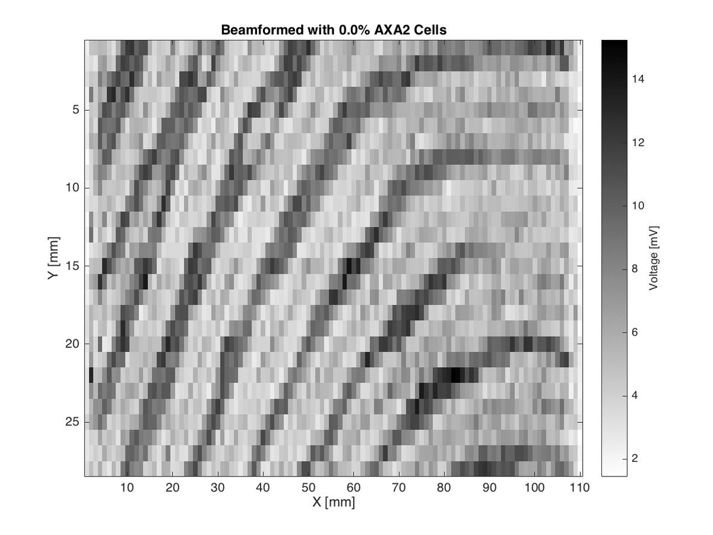

Approximate Delay and Sum Results

Slide 16
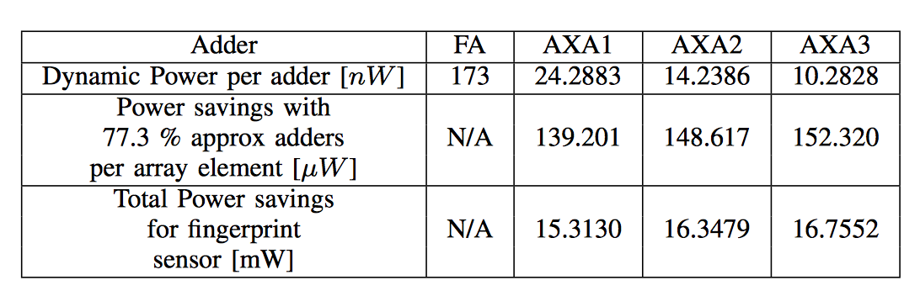
Power

Slide 17
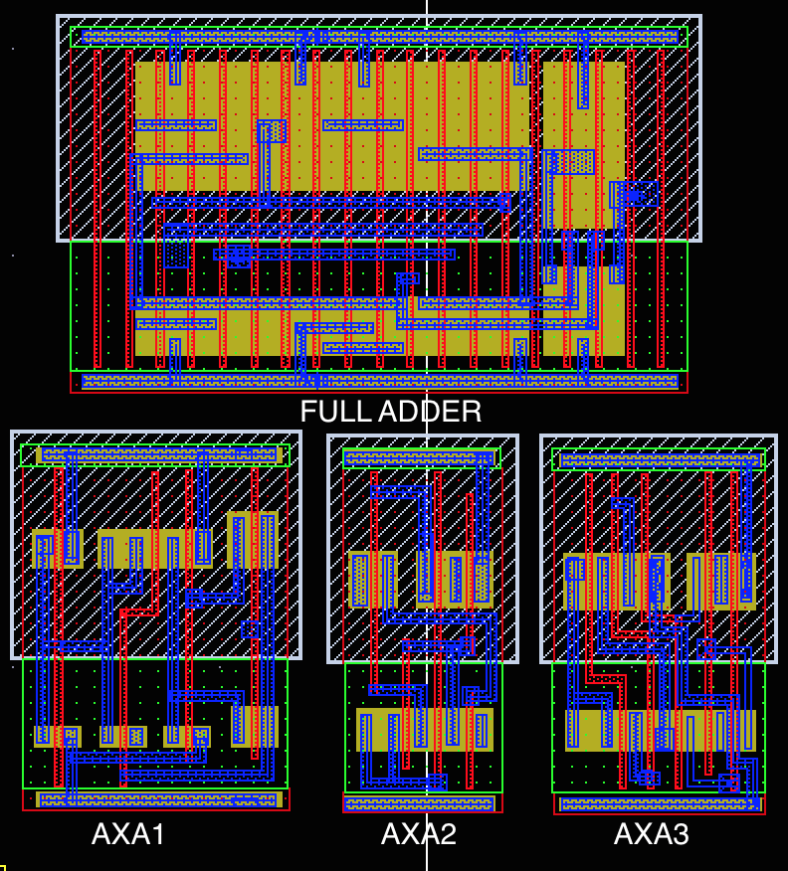
Cell Layout

Slide 18
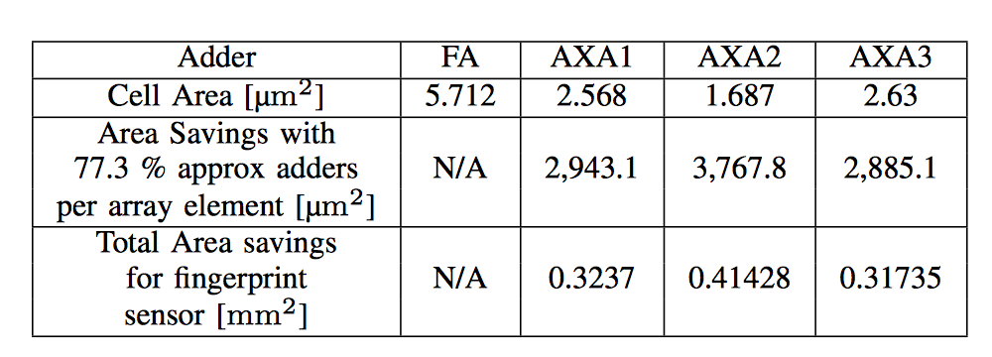
Area

Slide 19
Summary
Explored Approximate Compute as a power/area saving technique for Delay and Sum Beamformers
Analyzed accuracy of system with respect to degree of approximation for 3 custom full adder cells
Observed up to 16.7 mW power and 0.414 mm² area saved for Approximate Delay and Sum Beamformer applied to a mobile ultrasonic imaging system

Slide 20
Thank You
Any Questions?

